Slide 1
Overview of
Decision Analysis
Fish 558; Day 2: 13h00-15h00

Slide 2
What is Risk Analysis?
One definition:
The probability of “something bad” happening
(e.g. probability of an earthquake occurring).
This definition is useful, but is perhaps a bit too narrow.
We could expand it to:
The evaluation of the consequences of alternative
management actions under uncertainty.
To conduct a risk analysis we need to think about what
“consequences”, “management actions” and “uncertainty”
are (and how to model them).

Slide 3
Risk Assessment and Risk Management
We focus on “risk assessment”, the art formulating management advice. However, “risk management” or how to respond to risk is at least as important.

Slide 4
Risk Assessment Problems
Typical questions:
  Calculate the probability that an endangered species will be rendered extinct.
  Determine the consequences of protecting an endangered species.
  Determine the consequences of changes in land use practices.
  Determine what will happen if a patient who appears to have a certain disease takes a certain drug.
Note: the first question pertains to the first definition of “risk analysis”, while the other three questions include broader considerations. All four questions are valid topics for a risk assessment.

Slide 5
Risk Assessment Problems
Too few: conservation biology / endangered species.
Too many: pest species.
How many: sustainable management.
How big: protected areas.

Slide 6
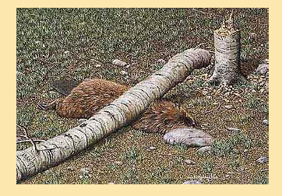
Why do we do Risk Analyses..

Slide 7
Hilborn’s Gambling Example
Consider the problem:
  There is a opaque box with 1000 balls in it. 200 balls are red and 800 are blue. You can bet on the color of a ball selected at random from the box. A bet on blue costs $20 and you win $60 if a blue ball is selected and a bet on red costs $5 and you win $105 is a red ball is selected.
Should you play the game? If so which ball should you bet on?

Slide 8
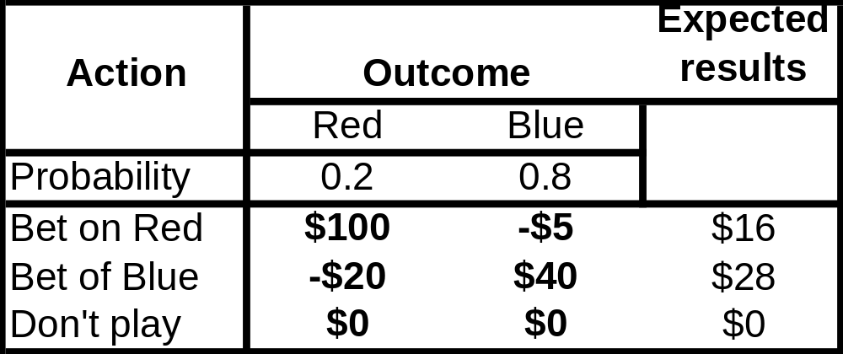
Hilborn’s Gambling Example
So, what is the best way to proceed?

Slide 9
Hilborn’s Gambling Example
What to do depends on your “utility function”, i.e. your response to risk and reward:
  if you bet based on expected values, you would bet on blue;
  you might bet on red because it gives a bigger reward; and
  you might play red if you have $20 because you know you can play at least four times before “losing everything”.
Clearly there is no “correct” answer to even this simple problem. However, the decision table highlights the basic information.

Slide 10
Components of Decision Analysis-I
Hilborn’s game highlights the four key elements of a decision analysis:
  The outcome (or “state of nature”) - “red” or “blue”.
  The alternative actions - “bet on red”, “bet on blue”, “don’t play”.
  The consequences of each action if each state of nature is true.
  The probability of each state of nature.
Calculating the “probability of something bad happening” could be part of Step 3.

Slide 11
Components of Decision Analysis-II
Defining States of Nature:
  This is more of an art rather than a science. Sometimes the state of nature is obvious (“red” and “blue”), but more commonly it is not. Often the states of nature capture some of the key sources of uncertainty.
Selecting Management Actions:
  This is usually not the responsibility of the analyst; rather it is something done by the decision makers.
Assigning probabilities:
  We will cover this when we discuss Bayesian methods
Summarizing the consequences of management actions
  Forecasting and including uncertainty. Today we will talk about some of the methods used for forecasting.

Slide 12
Summarizing the Consequences of Management Actions.
This will be a key theme throughout this course, but we will start by thinking about how to forecast the consequences of alternative catch streams for Cape hake.
Projections (or forecasting) involves extrapolating models based on current conditions (and any associated uncertainty) into the future given assumptions about the future.

Slide 13
Forecasting-I
Things to specify when forecasting:
  How to summarize the outcomes (what summary statistics)?
  How long? (20 years?)
  What uncertainties to consider (what uncertainties to “integrate out” into the summary statistics)?

Slide 14
Uncertainty
“The incompleteness of knowledge about the state or processes (past, present, and future) of nature”
(FAO, 1995)

Slide 15
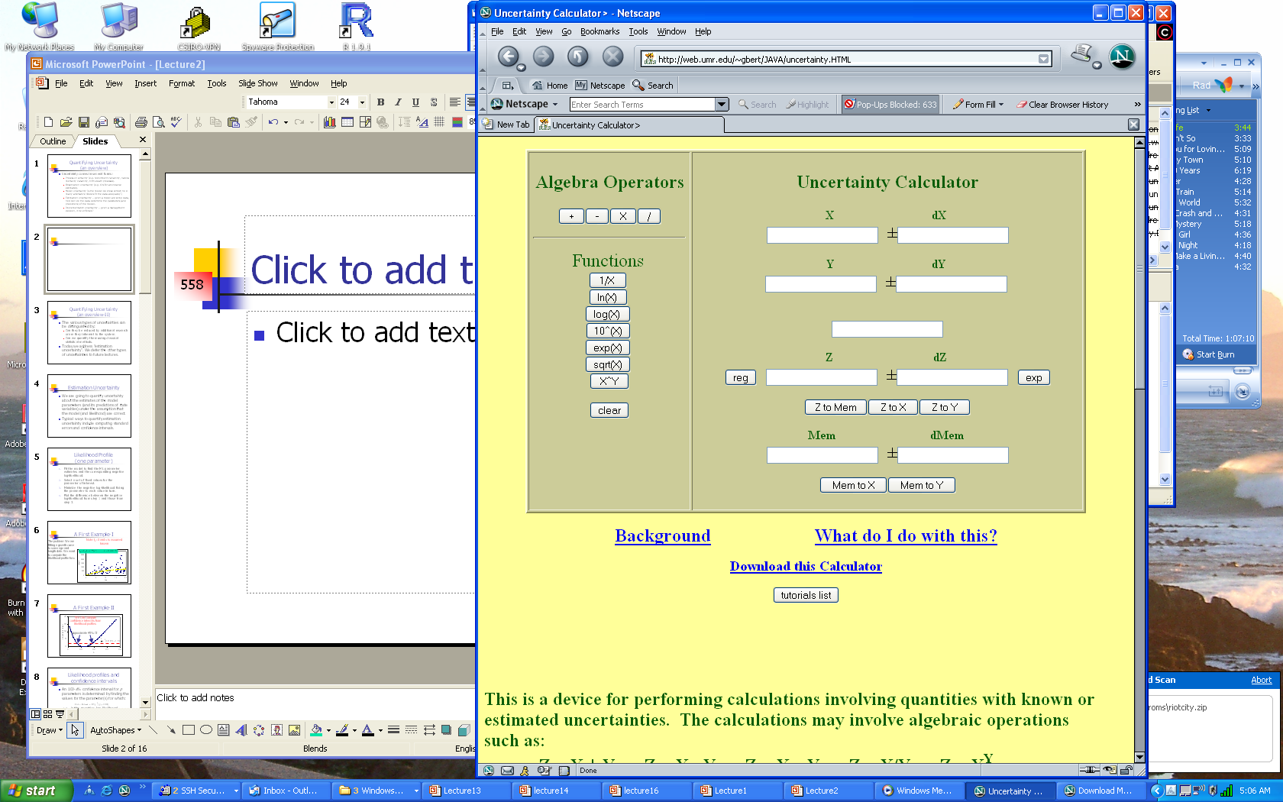

Slide 16
Uncertainty
How much uncertainty you decide to include in any particular analysis is as much an art as a science.
Uncertainty comes in several forms:
  Process uncertainty (e.g. recruitment variability, natural mortality variability, birth-death processes).
  Observation uncertainty (e.g. CVs for abundance estimates).
  Model uncertainty (is the model we chose correct; how many alternative models fit the data adequately?)
  Estimation uncertainty – given a model and some data, how well do the data determine the parameters (and predictions) of the model.
  Implementation uncertainty – given a management decision, can it be enforced?

Slide 17
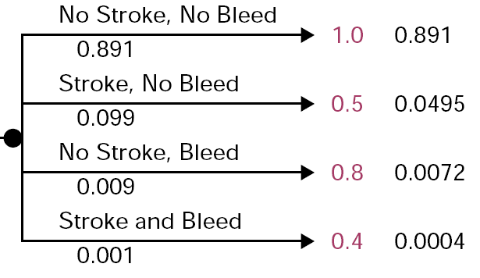
Projecting forwards
(A medical example)
Probability of
each outcome
given treatment
Numerical “score” for each
qualitative outcome

Slide 18
Selecting States of Nature-I
The States of Nature depend on the problem at hand:
  Population removals: Current population size, natural mortality, productivity, future regime, ….
  Habitat restoration: Habitat type, amount of impact/ damage, productivity…
  Strategies for recovering endangered species: Dynamics at low population size, current population size, extent of density-dependence….

Slide 19
Selecting States of Nature-II
To determine whether a factor is a “state of nature”:
  Is it discrete, e.g.:
    is data set X valid for this problem / habitat type?
    is model A or model B more appropriate for this problem?
  Is the value of an outcome likely to change substantially depending on the factor; perhaps we should not “integrate out” the factor, e.g.:
    Productivity at low population size?
    Current population size (for catch quotas).

Slide 20
Selecting States of Nature-III
Additional notes / suggestions:
  Take care to avoid having too many states of nature – a decision table with more than about 8 columns gets very hard to follow.

Slide 21
Selecting States of Nature-IV
Having a factor be a state of nature allows the decision maker to “see” its impact
Consider the following problem:
  there is a stock for which the Schaefer model r and K are unknown, r may be 0.1, 0.2 or 0.3 and K may be 1000, 2000 or 3000 (each value for r and K are equally probable);
  the current population size is 20% of K;
  The population dynamics are deterministic;
  the management actions are harvest rates of 0.05, 0.1 and 0.15 (r/2); and
  the summary statistic is the depletion (B/K) in 20 years.
  Should r or K (or both), current population size,…, be the states of nature?

Slide 22
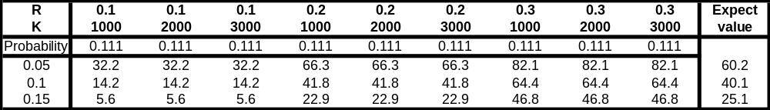
Selecting States of Nature-V
Points arising:
  Was this what you expected?
  On the basis of this result how would you construct a decision table for a fixed quota?
  Would the expected value be sufficient for you to make a decision?

